Slide 1
PopUpFEM
Automated Abaqus/Python model generation for jumping cubes
Vasco Pires
Department Kunststofftechnik, Montanuniversität Leoben
6 February 2024

Slide 2
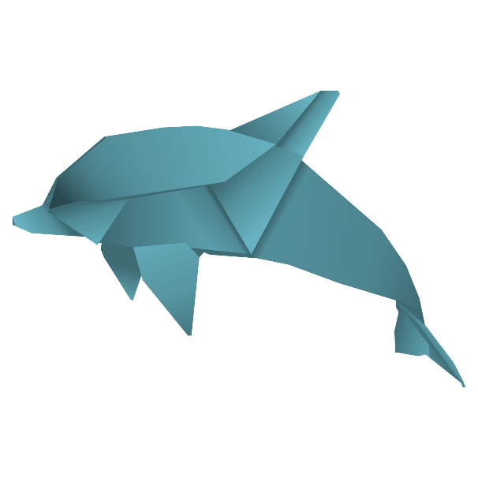

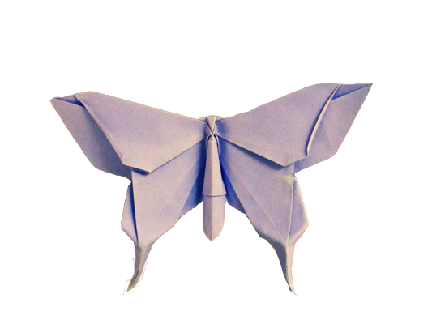
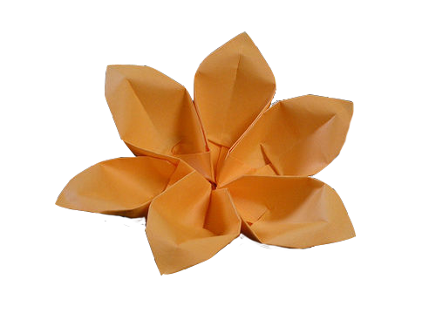
Introduction and Motivation
“Origami: the traditional Japanese art of paper folding, transforms a simple sheet of paper into intricate sculptures through a series of folds.”
Fig.1 – Origami examples.

Slide 3
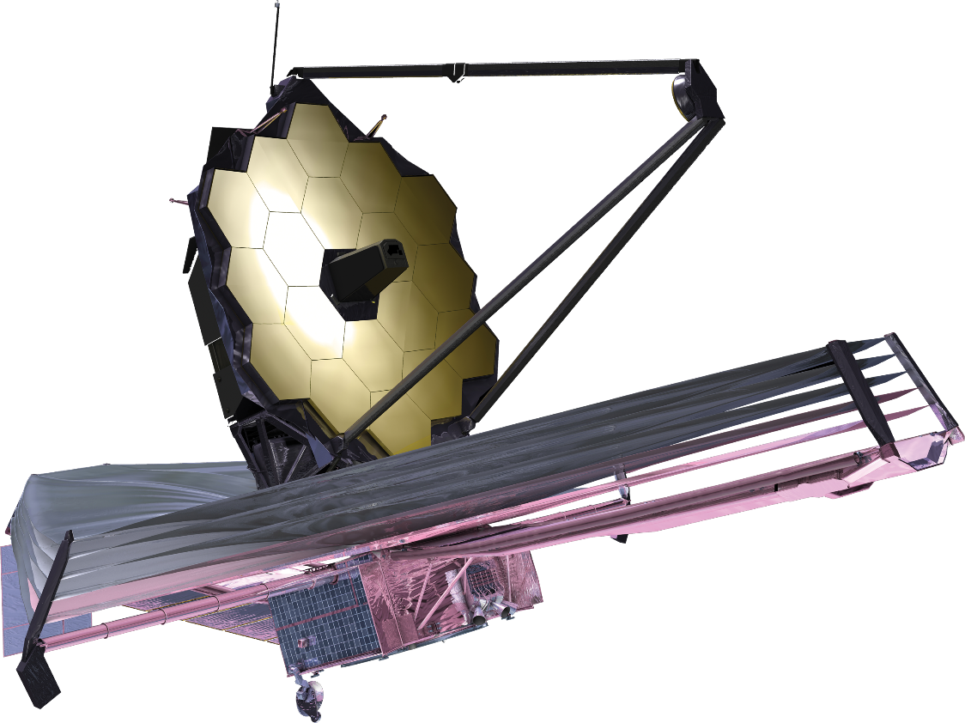
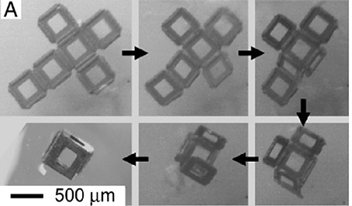
Introduction and Motivation
Even in engineering…
Optical Telescope
Sunshield
(a)
(b)
Fig.2 – Origami engineering applications. (a) James web telescope and (b) a self-folding microscale container that could be used for controlled drug delivery.

Slide 4
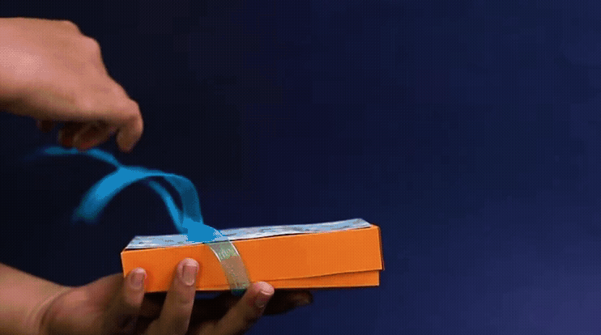
Pop Up Boxes - Idea
Origami with a rubber band attached into two anchor points that stretches when folded;
Once the elastic energy stored in the band is released, the boxes “Pop Up”
Fig.3 – Pop up boxes (from Venturo Art).

Slide 5
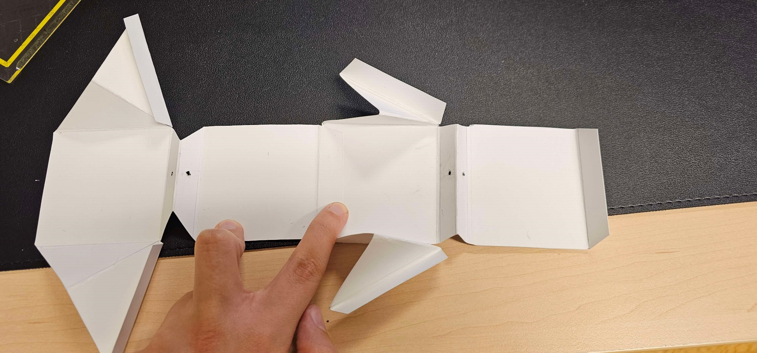
Pop Up Boxes – Assembly and folding
Glue
Rubber band
Fig.4 – Pop up box before assembly.

Slide 6
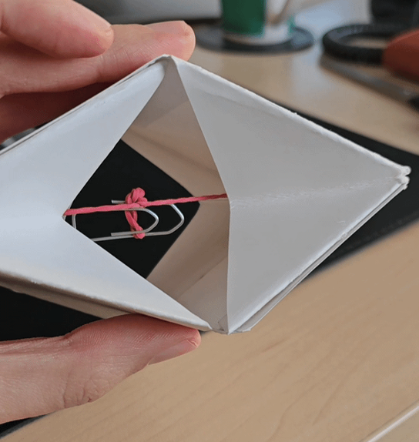
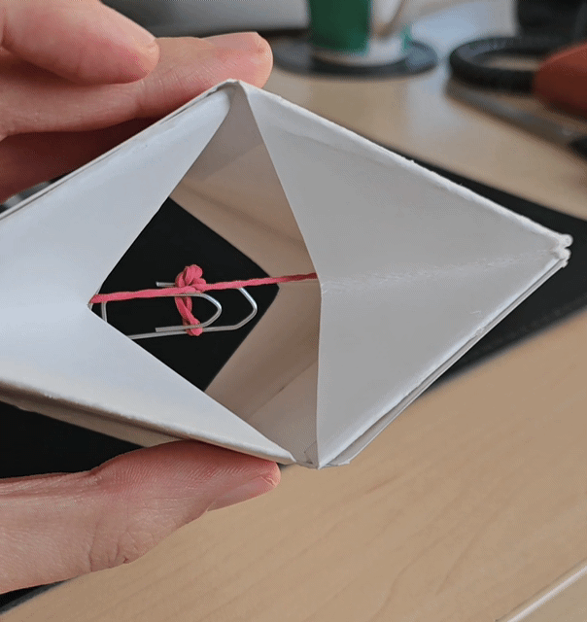
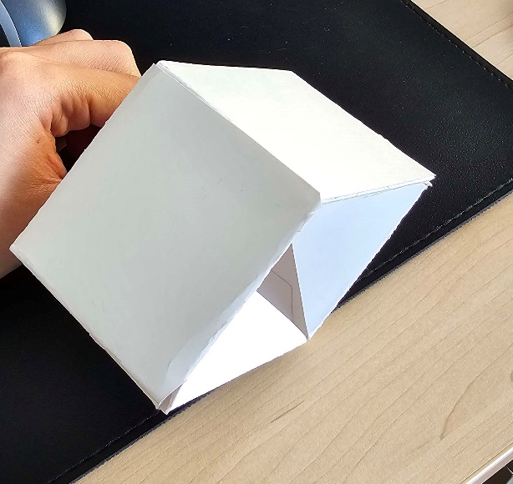
Pop Up Boxes – Assembly and folding
Inner Folds
Outer Folds
Fig.5 – Pop up box before assembly.

Slide 7
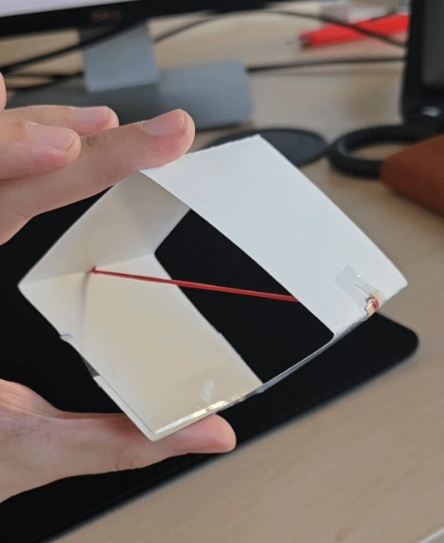
Pop Up Boxes – 2D Pop Up Box
4 Outer Folds
Captures the general mechanics of the system
Good starting point
Fig.6 – 2D Pop up box.

Slide 8
Modelling and Features

Slide 9
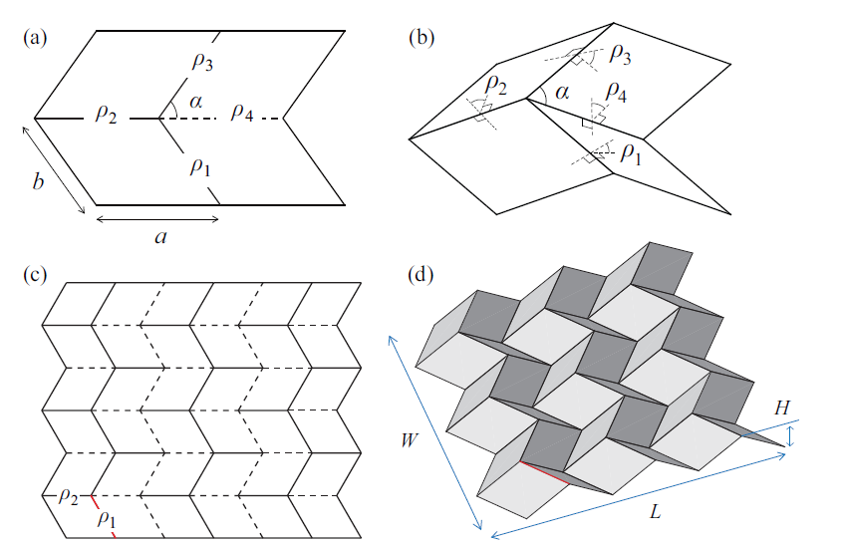
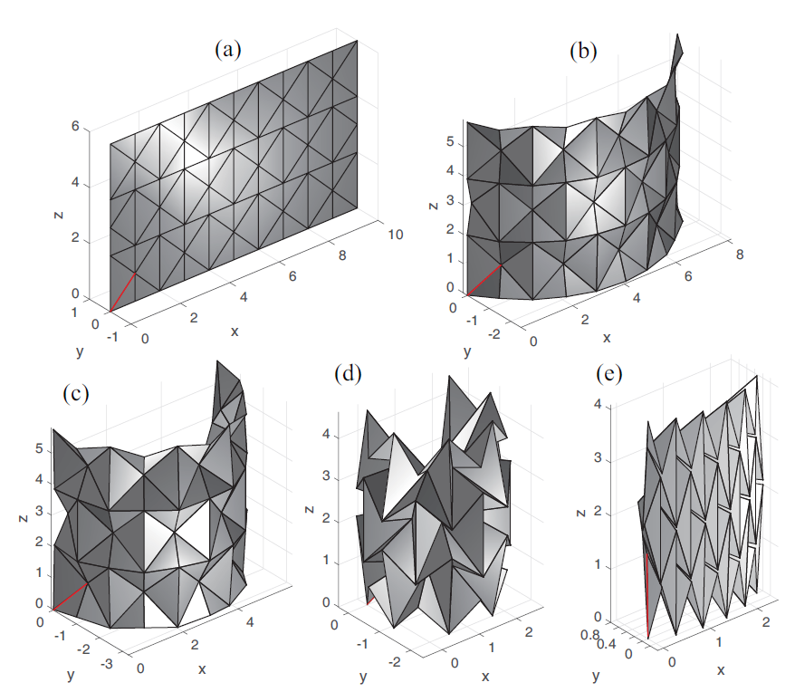
Modelling approaches to origami
How can we model folds?
There are certain axioms/rules that each crease pattern should follow.
“Moduli space" or "configuration space” is a mathematical space that represents all possible configurations of folds for a given origami model.
Mathematically defined origami
Fig.7 – (a) Parameters for the Miuri-ori unit cell. (b) Partially folded configuration. (c) and (d) Miuri-ori crease pattern.
Fig.8 – Different folding stages.
[1] Hu, Y., & Liang, H. (2020). Folding simulation of rigid origami with Lagrange multiplier method. International Journal of Solids and Structures, 202, 552–561. doi:10.1016/j.ijsolstr.2020.06.016

Slide 10
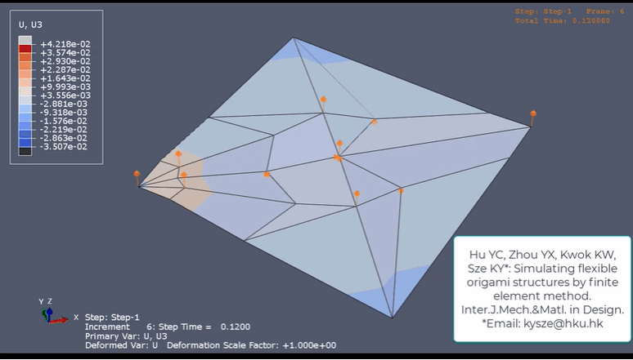
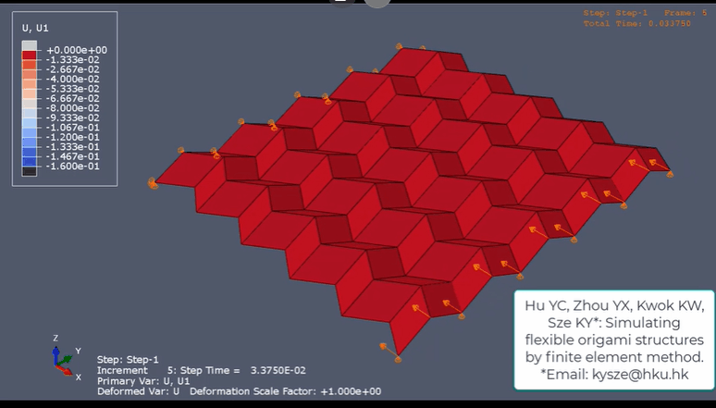
Modelling approaches to origami
Abaqus UEL subroutine – User Element Subroutine
(a)
(b)
Fig.9 – Origami folding using a costum UEL subroutine in ABAQUS. (a) Dove. (b) Miura-ori unit cell.
[2] Hu, Y.C., Zhou, Y.X., Kwok, K.W. et al. Simulating flexible origami structures by finite element method. Int J Mech Mater Des 17, 801–829 (2021). https://doi.org/10.1007/s10999-021-09538-w

Slide 11
Modelling approaches to origami
Two different materials are used, one for the folds and another one for the rest of the model. The crease material is considerably weaker.
Use of connecter elements.
Multi-material modelling
Fig.10 – Modelling of the folding and production of Tetra Pack package using FEM.
Tetra Pak packages
[2] Mameli, A., Borsari, R., Costa, S., & Fattore, L. (2010). Origami with Abaqus.

Slide 12

Modelling approaches to origami
Modelling approaches:
Multi-material problem
“Damaged” material in the folds
UEL subroutine
Connector elements
Tie constraints (without DOF)
Outside the scope of this course
Outside the scope of this course

Slide 13
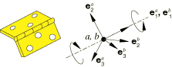
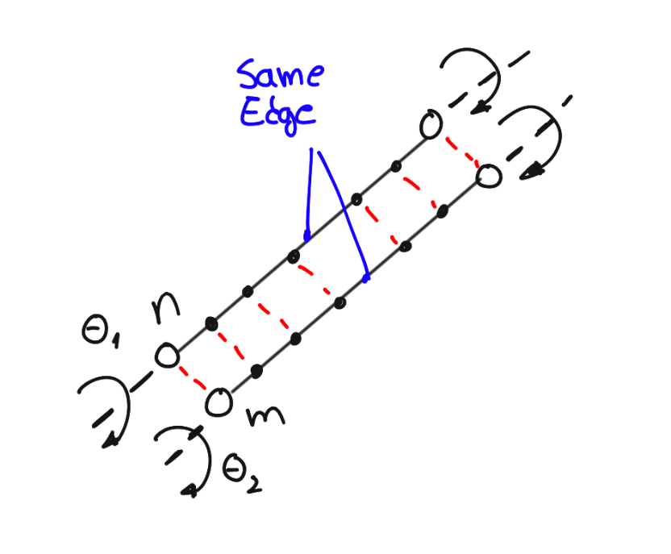
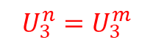
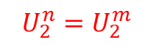
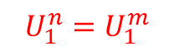
Connector elements vs Tie constraints
Connector elements
Connector elements in ABAQUS are ideal because it allows to prescribe:
Rotational stiffness;
Damping;
However, it requires for each fold/connector:
Wire between the relevant points;
Local coordinate system for each connector assignment;
Definition of the rotational DOF in the axis of the local coordinate system
Tie constraints w/o ROT
Cannot include rotational stiffness and damping on the formulation;
More elegant, easier to use and to implement.
Requires:
Master node set
Slave node set
$$U_{1}^{n}=U_{1}^{m}$$
$$U_{2}^{n}=U_{2}^{m}$$
$$U_{3}^{n}=U_{3}^{m}$$

Slide 14
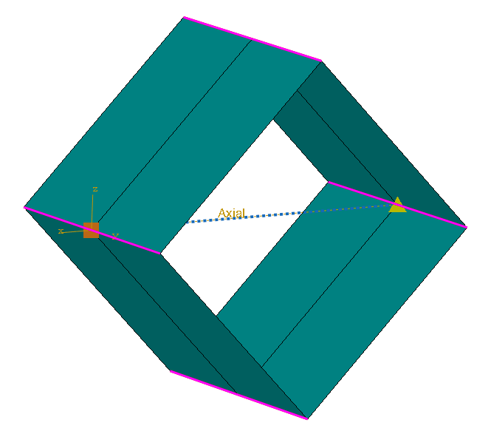
Base line model : 2D Pop Up Cube
Tie constraint
Axial connector: Spring
Fig.11 – 2D Pop up cube model.

Slide 15
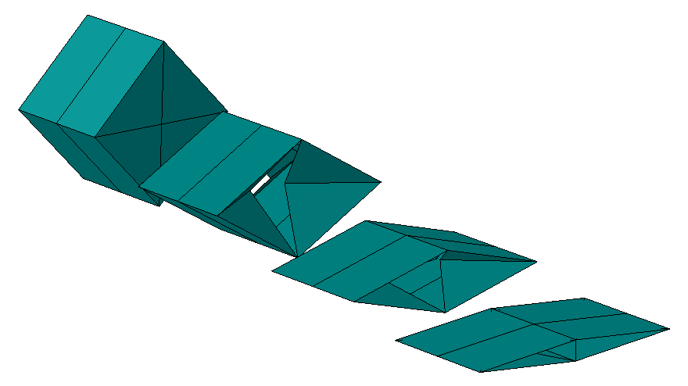
3D Pop Up Cube
The 3D model adds inner folds;
The folding angle is prescribed in the initial step of the model;
Each vertex of the model is defined parametrically using datum points:
Connected using Wires;
Convert to shells using the closed contours of the wires.
Decrease of fold angle
Step 1 – Initial: “Pre loading” using the prescribed angle
Step 2 – Explicit: “Release”
Fig.12 – 3D Pop up cube model for different fold angles.

Slide 16
Experimental procedures

Slide 17
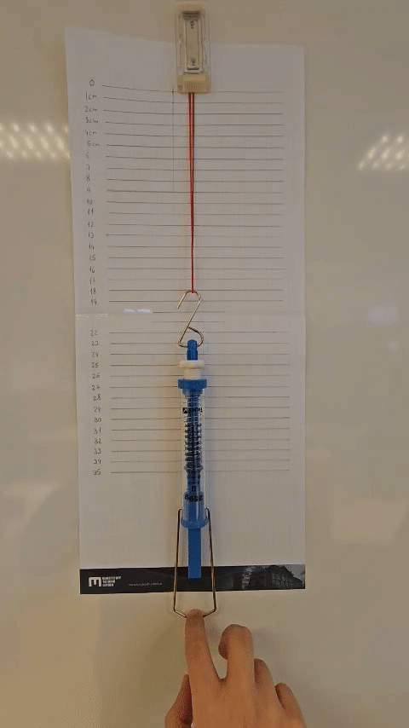
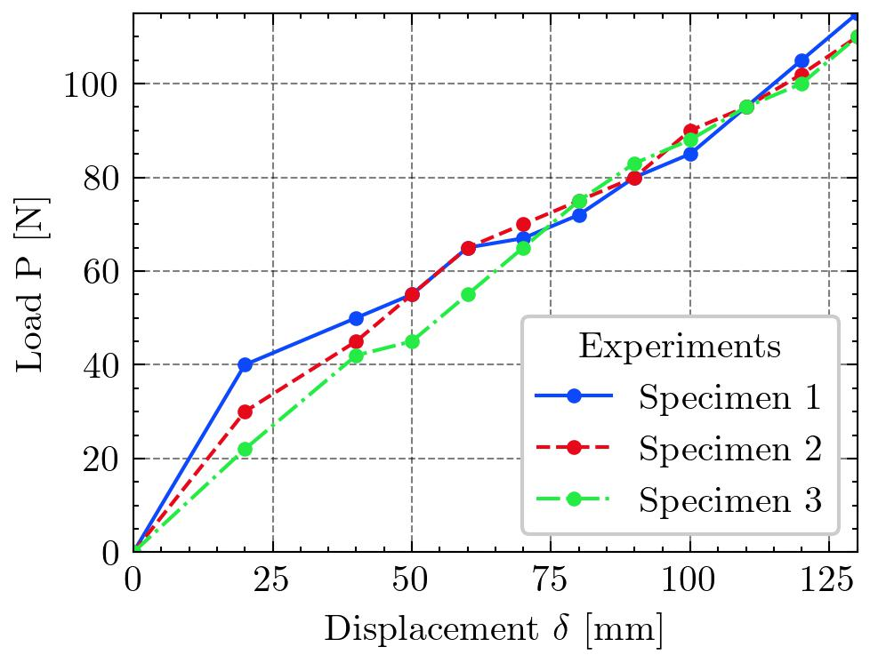
Determination of the rubber band stiffness
Fig.14 – Experimental setup for determination of the rubber band stiffness.
Fig.13 – Force – displacement plot for different specimens.

Slide 18
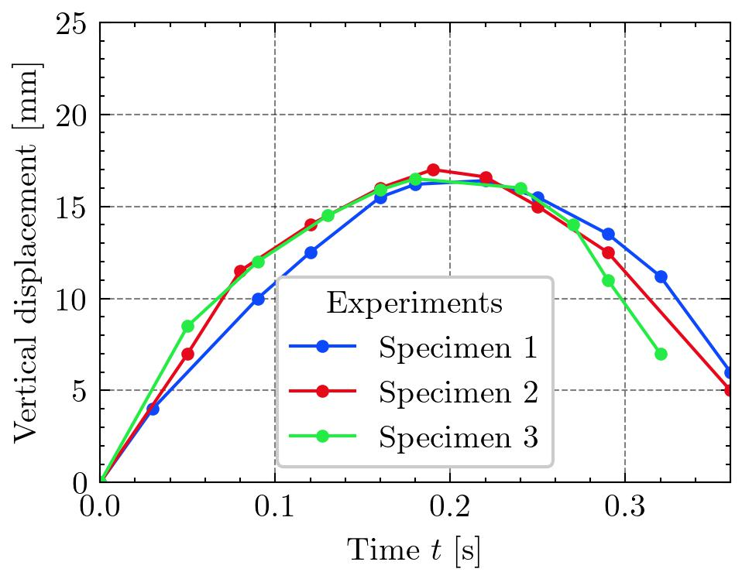
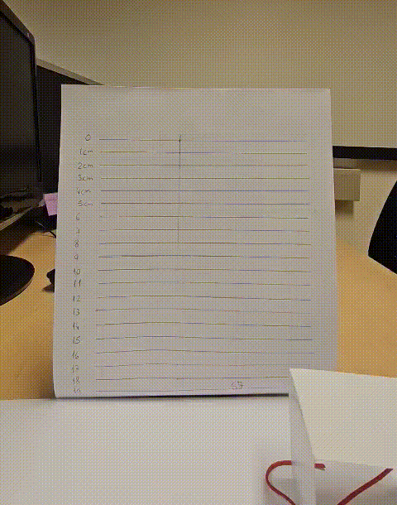
Maximum height for the 2D model
Fig.16 – Experimental setup for measuring the highest displacement point.
Fig.15 – Experimental vertical displacement over time for different specimens.

Slide 19
Scripting Usage

Slide 20
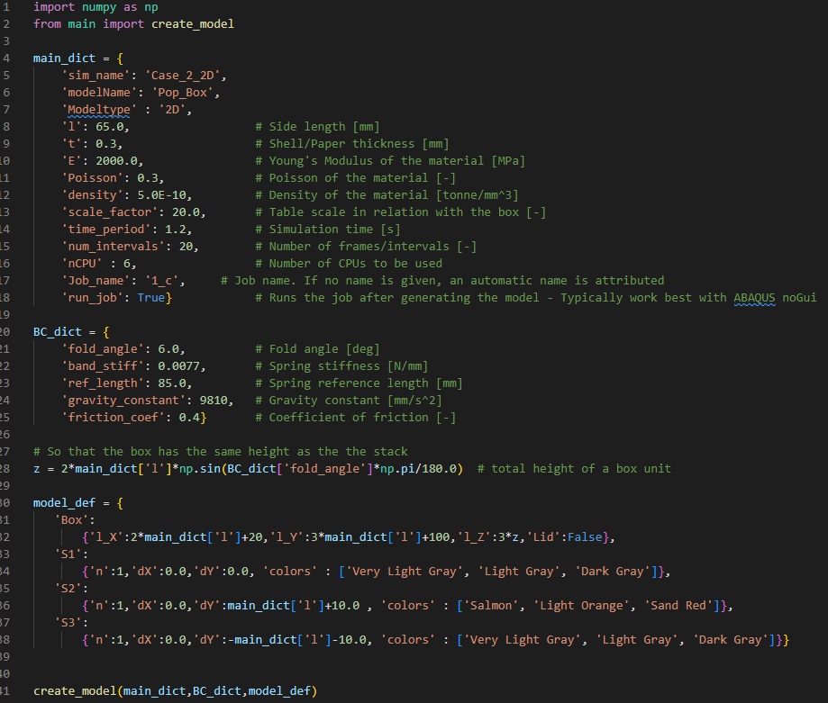
How to use the script
Dictionary with general model parameters
Dictionary with the boundary conditions

Slide 21
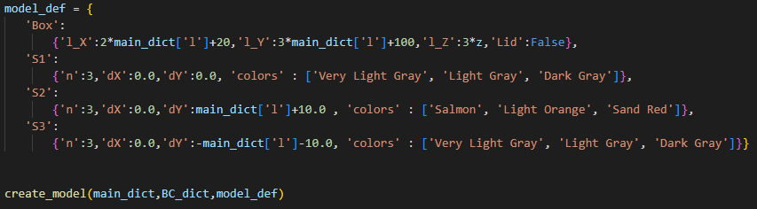
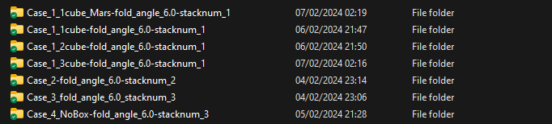
How to use the script
Dictionary with stack definition, position and color
Calls main function from another file
A folder with a .JSON file is created and the simulation files is automatically created;
The .JSON file is necessary for the post-processing script.
If FFmpeg is installed, a gif can be generated using the simulation frames (a image is generated for each frame in a separate folder).

Slide 22
Some results and use cases

Slide 23
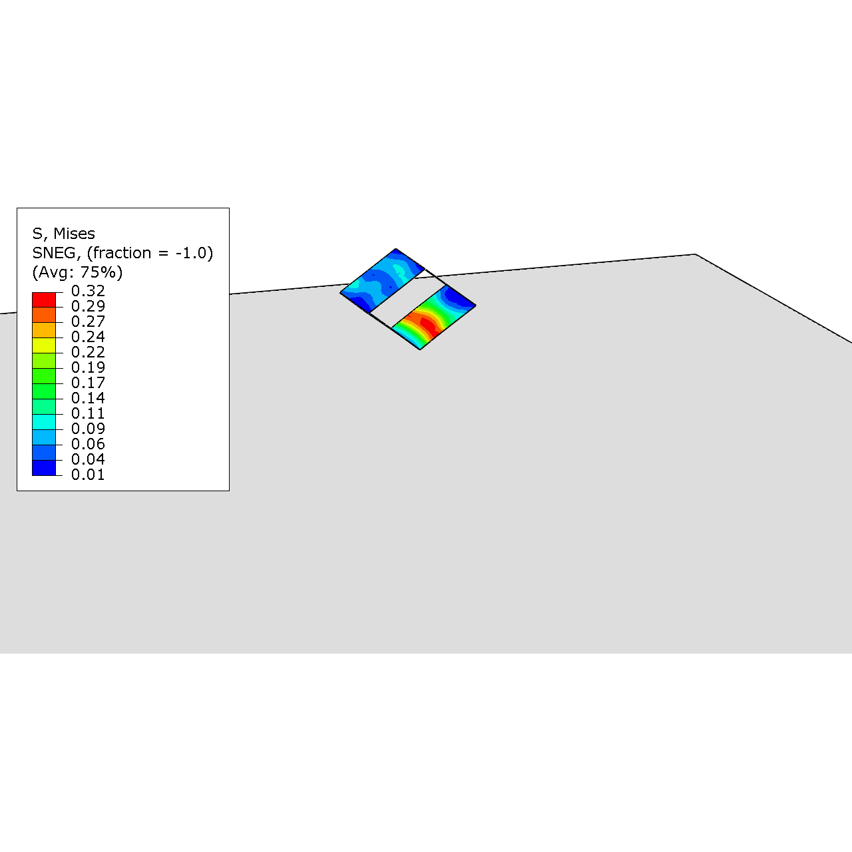
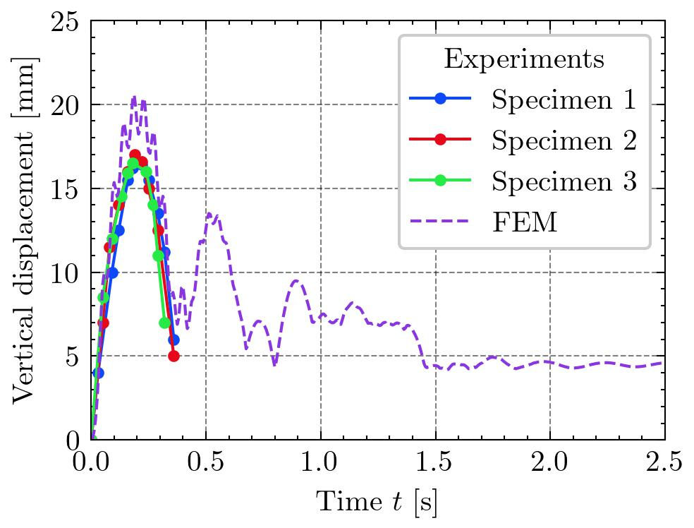
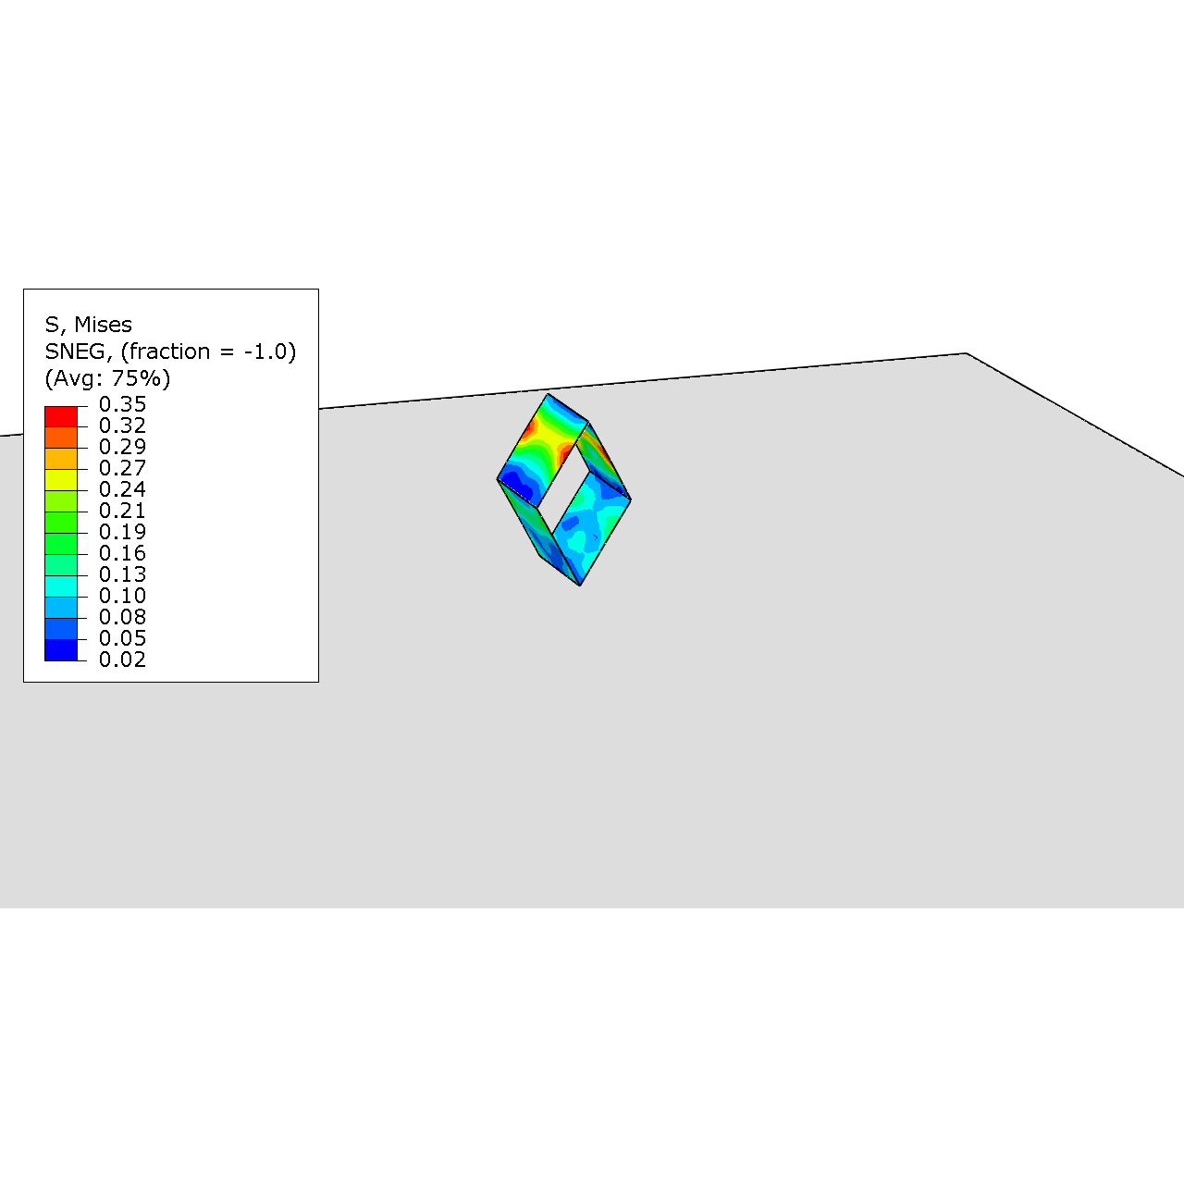
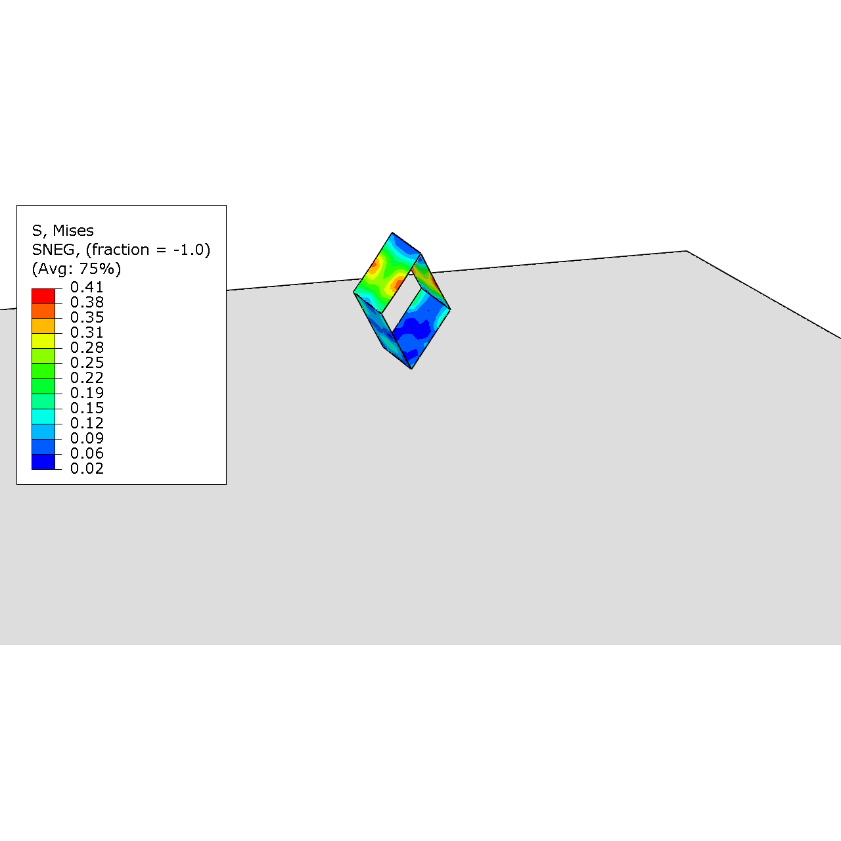
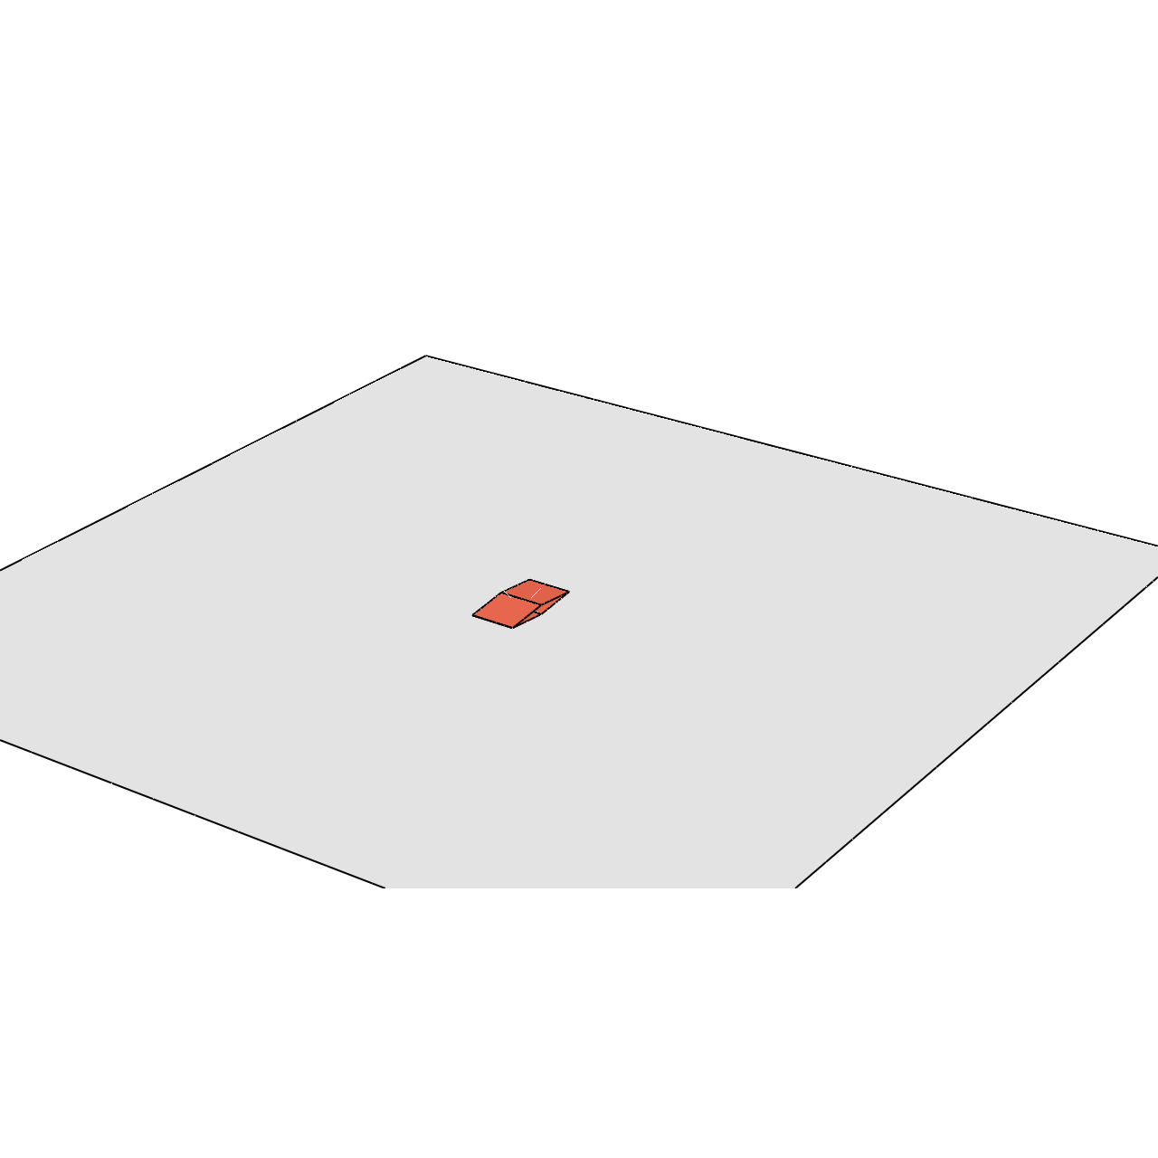
2D Pop Up Box
Related with the “wobbling” of the cube
1
2
3
Fig.17 – Comparison between experimental and FEM results for the vertical displacement of the top node of the 2D Pop Up Box.

Slide 24
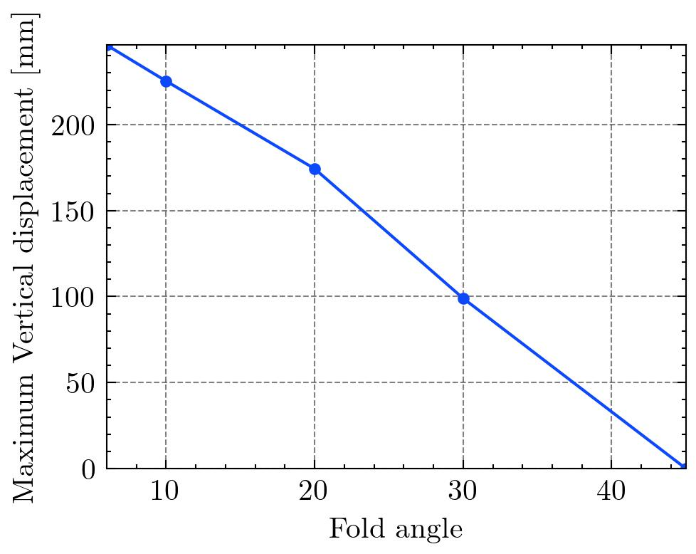
2D Pop Up Box for different folding angles
Fig.18 – Comparission between the maximum vertical displacement and the fold angle for the 2D model.

Slide 25
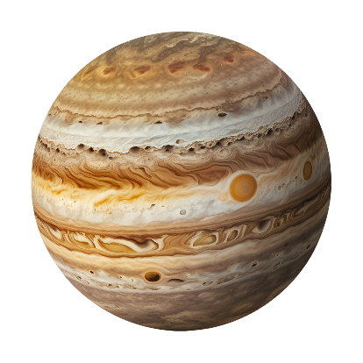
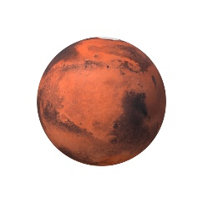


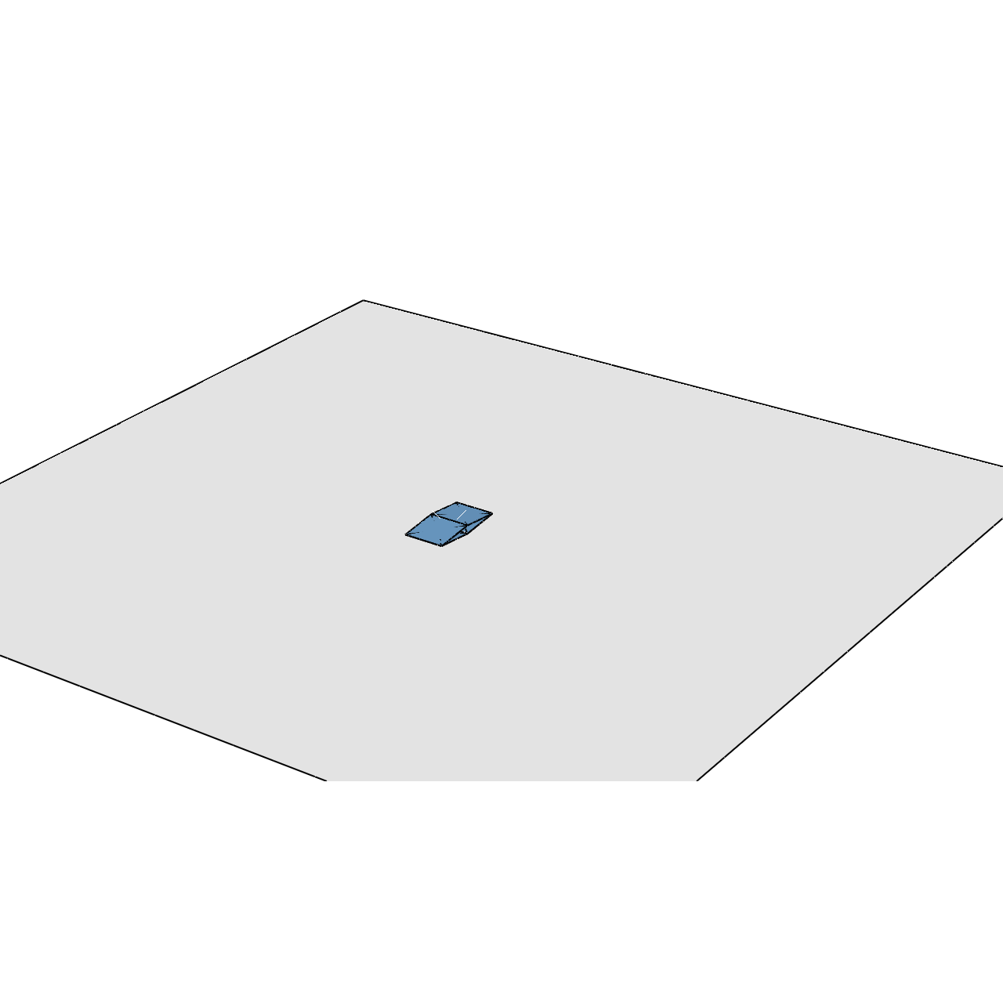
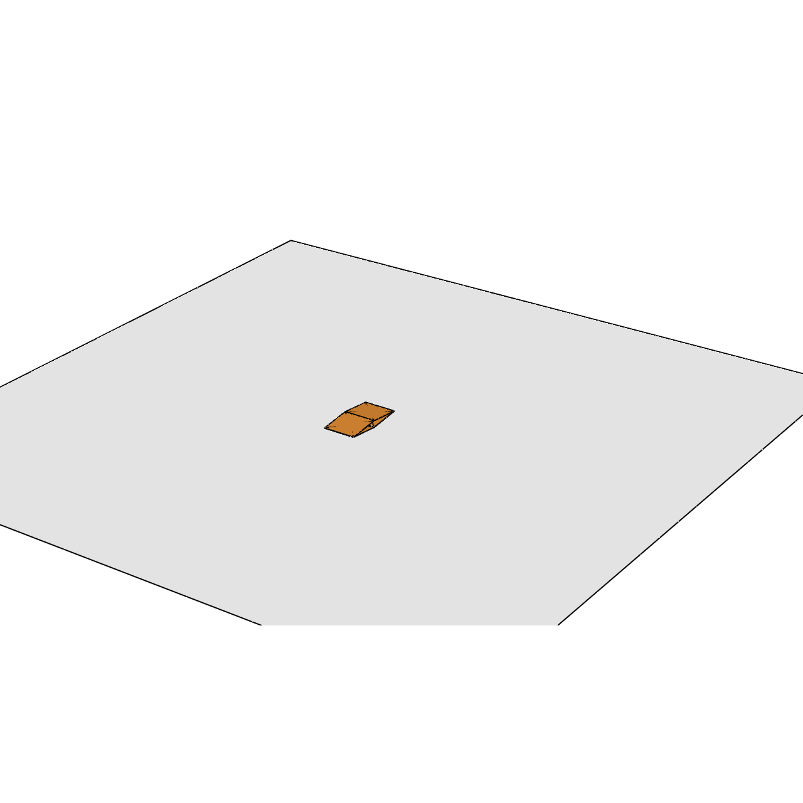
3D Pop Up Box – Different Planets
Fig.19 – Effect of gravity in a single pop up cube.

Slide 26


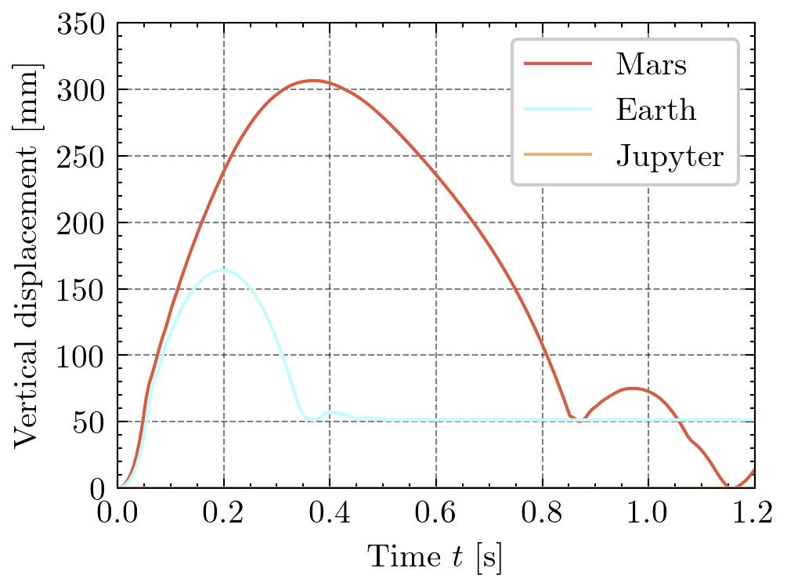
3D Pop Up Box – Different Planets
Fig.20 – Vertical displacement of a cube depending on the gravity constant.

Slide 27
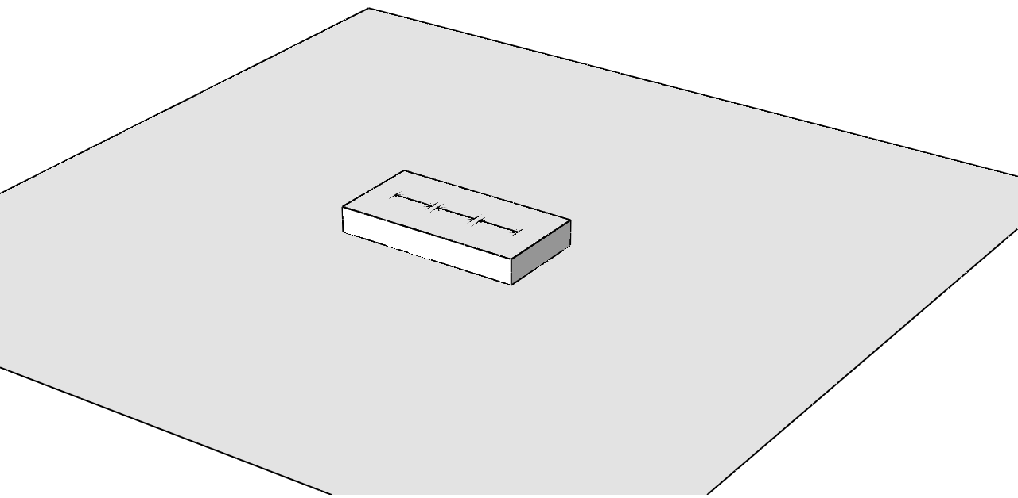
Stack of cubes in a box
Fig.21 – Stacks of 3 pop up boxes

Slide 28
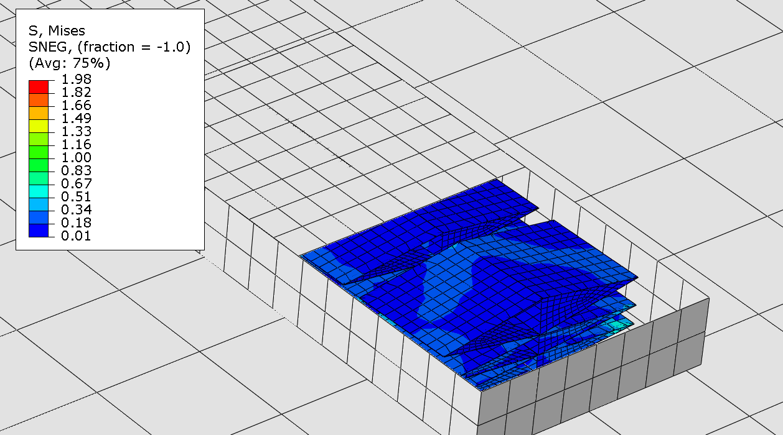
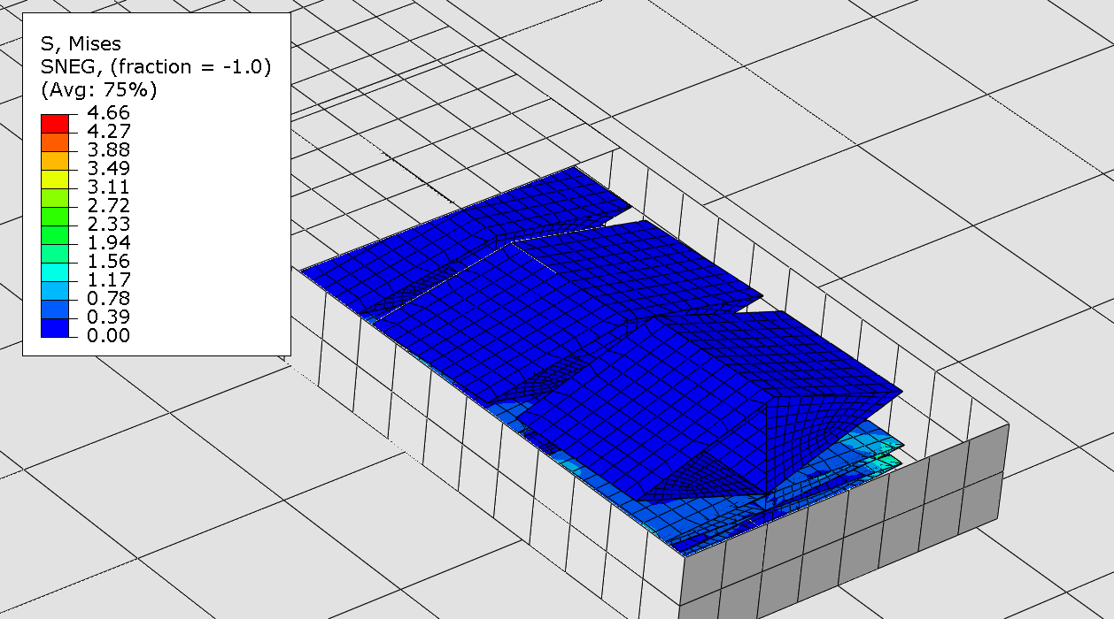
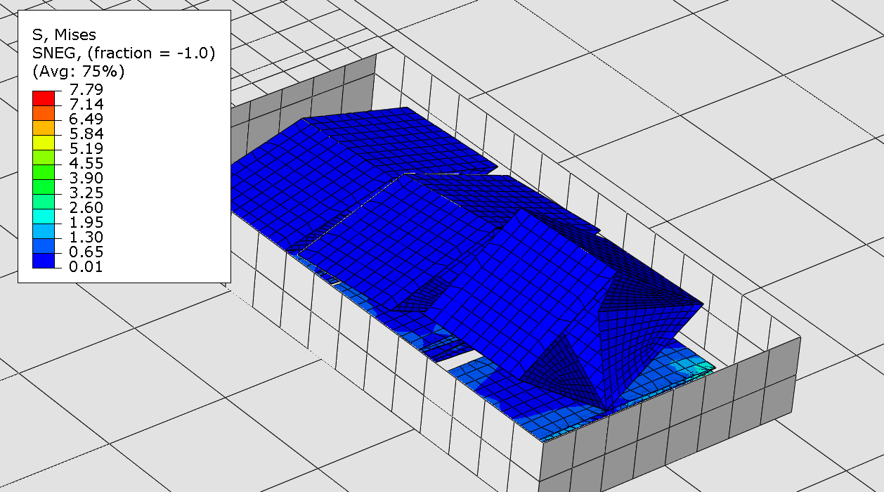
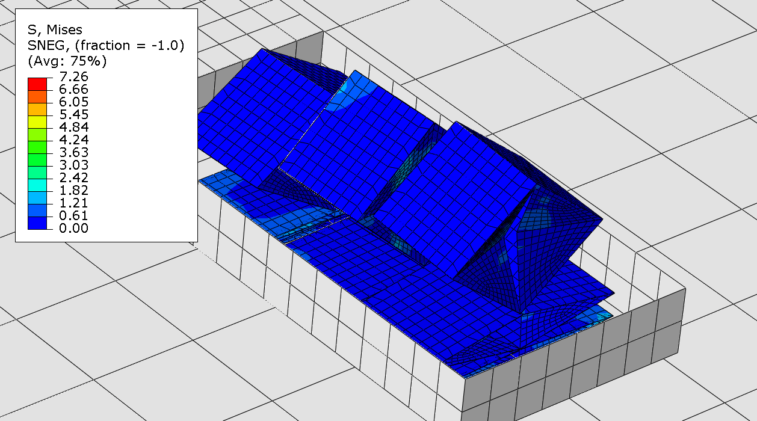
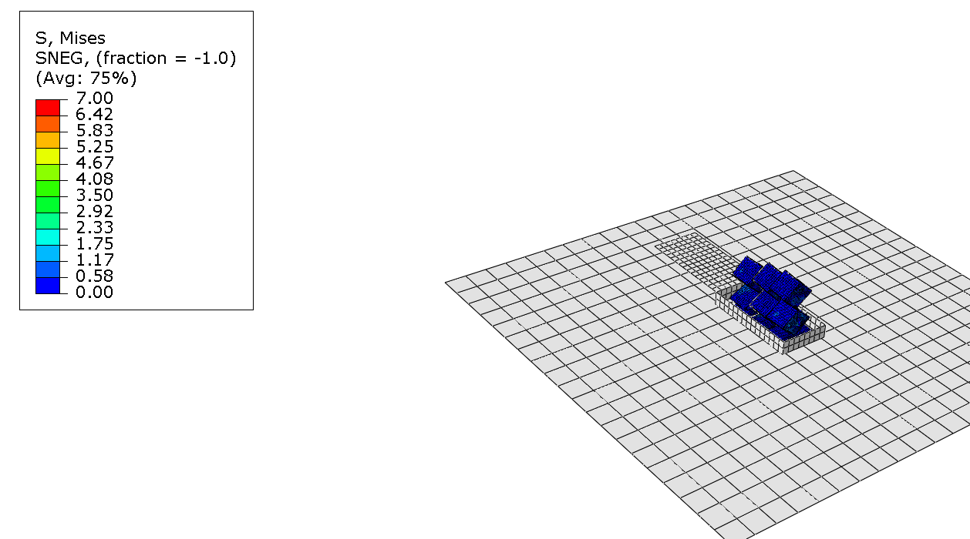
Stack of cubes in a box
1
2
3
4
Compression of the cubes below.

Slide 29
Conclusions

Slide 30
Conclusions
A ABAQUS Python tool for modelling pop up cubes was developed;
The most suitable modelling technique to model folds was Tie Constraints with no ROT DOF;
Some experimental results were obtained and compared with the scripted models results, showing a good agreement;
The project served as a good starting point to learn origami modelling in ABAQUS;

Slide 31
Questions?

